Slide 1
Analysing Stock Market Movements Using Twitter Sentiment Analysis
PREPEARED BY
NIRALI PATEL (A20345459)
JAIMIN SANGHVI (a20344798)

Slide 2
INTRODUCTION
Twitter.com is popular microblogging website
Each tweet contains 140 characters in length
Tweets are frequently used to express a tweet’s emotions on particular subject
The challenge is to gather all such relevant data, detect and summarize the overall sentiment on a topic and predict stock market movement

Slide 3
PROBLEM STATEMENT
Utilize social media to access market sentiment and predict the behavior of stock of certain company
Classify polarity of given text at document, sentence or feature level and determine whether opinion in text is positive, negative or neutral
Use machine learning algorithm to predict sentiment and find correlation between sentiment and stock prices

Slide 4
PROPOSED SOLUTION
Data collection
1. Using Twitter API to collect tweets(tweet text, date and time)
2. Using Yahoo Finance data feed together Stock market data
Tweet Sentiment Analysis
1. Using Naïve Bayes Classification
2. Using SVM model
Predict Stock market movement using tweet sentiment analysis
1. Using SVM model

Slide 5
METHODOLOGY
Twitter
Data Collection
Stock Market data
Sentiment Analysis
Price Analysis
Correlation of sentiment and message volume with price
Understanding of predictive capabilities of Twitter sentiment and effect of user reputation on stock market movement

Slide 6
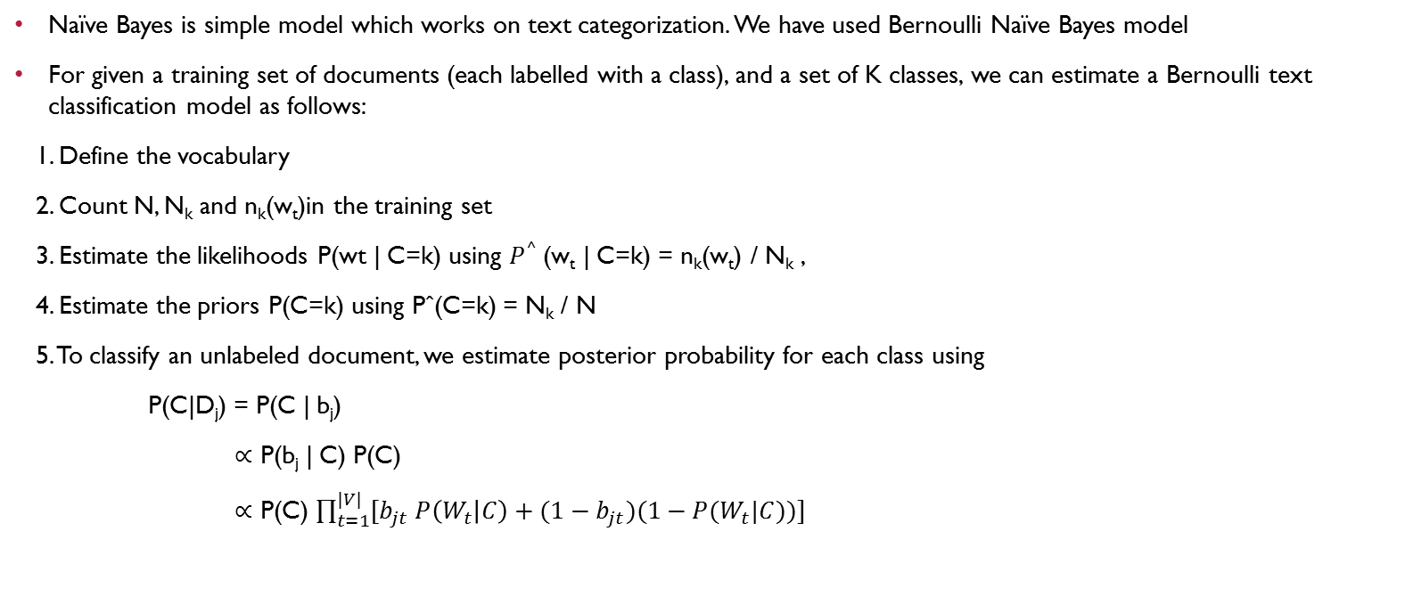
Naïve Bayes classification
Naïve Bayes is simple model which works on text categorization. We have used Bernoulli Naïve Bayes model
For given a training set of documents (each labelled with a class), and a set of K classes, we can estimate a Bernoulli text classification model as follows:
1. Define the vocabulary
2. Count N, N_{k} and n_{k}(w_{t})in the training set
3. Estimate the likelihoods P(wt | C=k) using $P^{^}$(w_{t} | C=k) = n_{k}(w_{t}) / N_{k} ,
4. Estimate the priors P(C=k) using Pˆ(C=k) = N_{k} / N
5. To classify an unlabeled document, we estimate posterior probability for each class using
P(C|D_{j}) = P(C | b_{j})
∝ P(b_{j} | C) P(C)
∝ P(C) $\prod_{t=1}^{|V|}{[b_{jt} P\left(W_{t} | C\right)+(1−b_{jt})(1−P(W_{t}|C))]}$

Slide 7
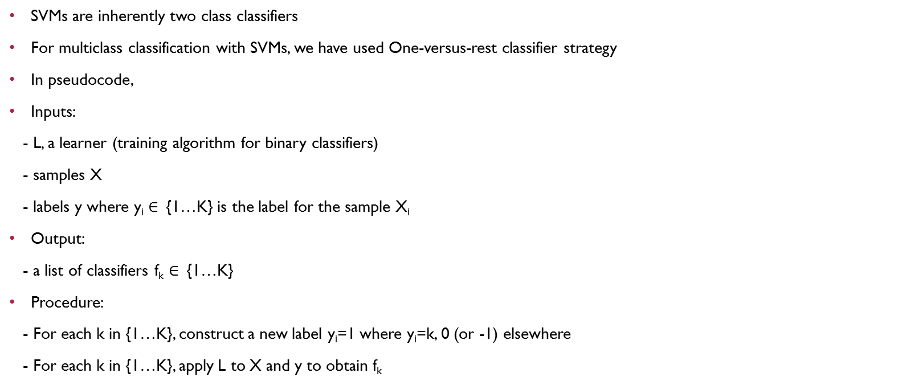
Support vector machine
SVMs are inherently two class classifiers
For multiclass classification with SVMs, we have used One-versus-rest classifier strategy
In pseudocode,
Inputs:
- L, a learner (training algorithm for binary classifiers)
- samples X
- labels y where y_{i} $∈$ {1…K} is the label for the sample X_{i}
Output:
- a list of classifiers f_{k} $∈$ {1…K}
Procedure:
- For each k in {1…K}, construct a new label y_{i}=1 where y_{i}=k, 0 (or -1) elsewhere
- For each k in {1…K}, apply L to X and y to obtain f_{k}

Slide 8
RESULTS
Company | Positive | Negative | Neutral | Total
AAPL | 25 | 14 | 61 | 100
GOOG | 28 | 8 | 64 | 90
YHOO | 35 | 4 | 61 | 100
MSFT | 20 | 8 | 72 | 100
GS | 17 | 15 | 68 | 98
Model | Accuracy | Precision | Recall | F-Measure
Naïve Bayes Bernoulli | 0.8039 (80.39 %) | 0.4615, 0.45, 0.9710 | 0.75, 1.0, 0.7882 | 0.5714, 0.6207, 0.8701
Support Vector Machine | 0.8431 (84.31 %) | 0.6923, 0.65, 0.9275 | 0.5625, 1.0, 0.8767 | 0.6206 0.7878, 0.9014

Slide 9
RESULTS
Apple (AAPL)
Goldman Sachs (GS)
Accuracy: 0.7876 (78%)
Other Errors:
 | Class 0 | Class 1 | Class 2
Precision | 0.5416 | 0.0769 | 0.9474
Recall | 0.65 | 1 | 0.7826
F-Measure | 0.5909 | 0.1428 | 0.8571

Slide 10
THANK YOU!!

